Slide 1
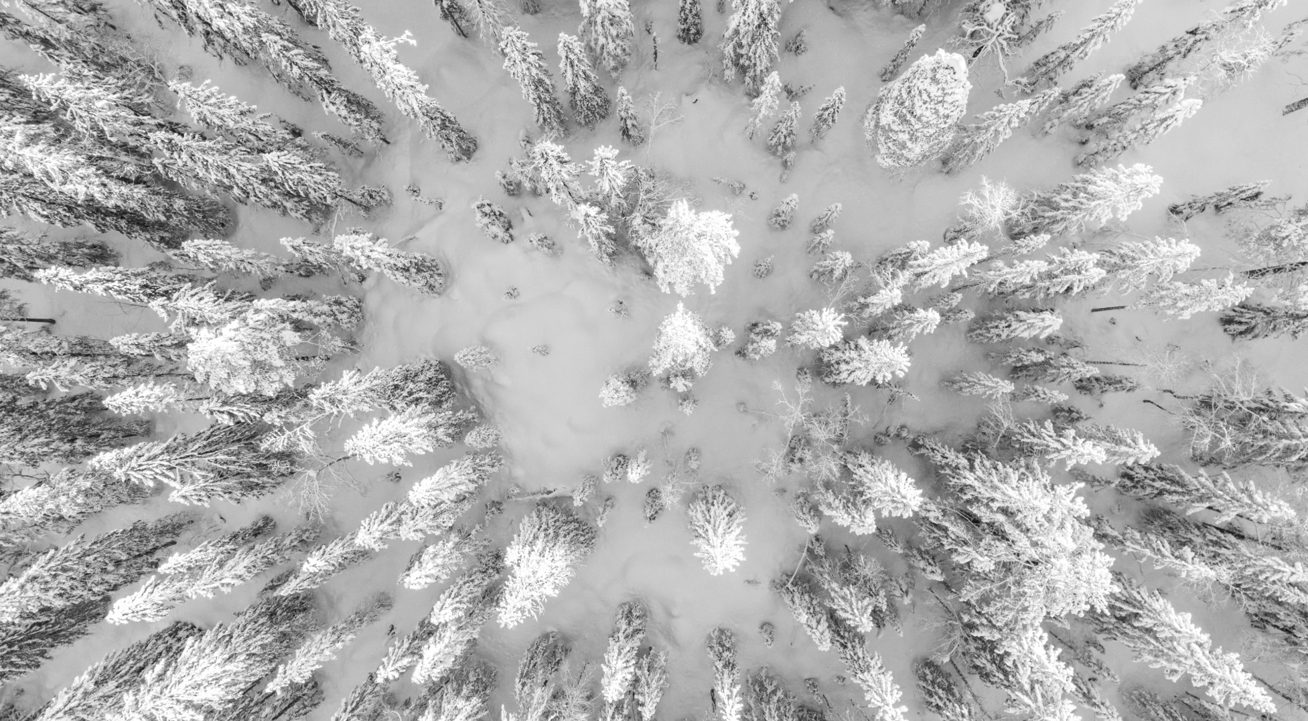
Big Mountain Resort
Ticket Price Analysis

Slide 2
Problem Statement: How can Big Mountain Resort maintain or increase their current ticket price to remain competitive in their market segment by reducing costs or capitalizing on its facilities for the next ski season
Context
Big Mountain resorts boasts 105 trails with spectacular views of Glacier National Park and Flathead National Forest. About 350,000 visit the park every year of different skill levels. Recently Big Mountain installed an additional ski lift to increase distribution of visitors across the mountain, which carries an additional operating cost of $1,540,000 this season. To offset this cost, Big Mountain has increased their daily ticket rates but realize that may not be the best solution. Ownership is looking for ways to cut costs without the need to adjust their price or improve on existing facilities to be able to increase prices.
Criteria for Success
Provide a data-driven business strategy.
Scope of solution space
The focus will be on optimizing ski related aspects of the resort.
Constraints within solution space
Total skiable area covered in lights for nighttime skiing is missing from data source.
Operating costs of on-premise facilities not available.
Stakeholders to provide key insight
Big Mountain ownership/management
Database Manager
Key Data Sources
CSV fike provided by Big Mountain Database Manager

Slide 3
Recommendation and Key Findings
Recommendation:
Per the 4 scenarios proposed by the Big Mountain, the best option would be to add an additional run, increase the Vertical Drop by 150 ft and install an additional chair lift. The model indicates this will allow for a Ticket Price increase of $8.61.
Key Findings:
Based on current features, the model suggests current ticket prices should be set at $95.87
Closing down more than 1 run will would require a ticket price decrease and would directly impact revenue
Adding 2 acres of Snowmaking on top of the Recommendation will allow for a negligible additional price increase
Increasing the longest run by 0.2 miles and increasing Snowmaking capacity does not support any change in price

Slide 4
Process: Data Collection/Cleaning
Obtained Resort Data for 330 resorts across the US from Big Mountain Database Manager. This included 27 data points (features). The following steps were taken to ensure a clean data set.
Corrected inaccurate data
Dropped features with large percentage data missing
Dropped Resorts missing ticket pricing
Obtained State Population and Area data from Wikipedia to calculate per capita information to include in resort analysis.
https://simple.wikipedia.org/w/index.php?title=List_of_U.S._states&oldid=7168473
Cleaned data contains 277 Resorts with 25 data points.

Slide 5
Process: Exploratory Data Analysis / Pre-Processing and Training
Exploratory Data Analysis – Key Findings
Approximately 75% of the resort differences come from 2 features
Approximately 95% of the resort differences come from 4 features
Big Mountain resort can safely be compared to all other resorts, not just resorts within Montana.
Features: Vertical Drop, Fast Quads, Runs and Total Chairs show a positive correlation with Ticket Price.
Pre-Processing and Training
Removed Big Mountain from the data to Train / Test Splits. 30% of Resorts were used for Testing Comparison
Applied 3 Linear Regression Models (R², Mean Absolute Error, Mean Square Error)
Applied Random Forest Model
Applied Cross Validation on all Models
Random Forest Model had the least Cross Validation Mean Absolute Error and exhibited the less variability

Slide 6
Summary and Conclusion
Big Mountain’s objective was to either eliminate overhead costs or to increase prices, or a combination of both. Based on the data available, the only monetary figures were ticket prices and so this analysis focused solely on that aspect. Additional information regarding operating costs for chairs in all forms would be useful in providing a better model / solution.
Based on the analysis, the features offered to directly correspond to Ticket Pricing. Any future planned changes to the features should be properly analyzed to determine the impact they could have on pricing. The model used in this analysis should be posted to Big Mountain’s servers for future use.
Key takeaways:
Current Ticket Prices can be increased based on existing features when compared to all other resorts
Adding an additional run, increasing the Vertical Drop by 150 ft and installing an additional chair lift also supports increasing Ticket Prices

